Slide 1
Sikh
DR GURBAKSH SINGH

Slide 2
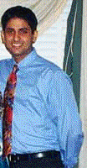

How can you be a Sikh?
A Sikh young man from California joined the medical college in Szeged, Hungary.
He was not keeping long hair nor did he wear a turban.
In a casual dialogue, a Jewish friend asked him, “What’s your faith?”
The Sikh replied, “I am a Sikh.”
In great surprise, his friend immediately retorted, “How can you be a Sikh? You cut your hair and you do not even wear a turban.”

Slide 3
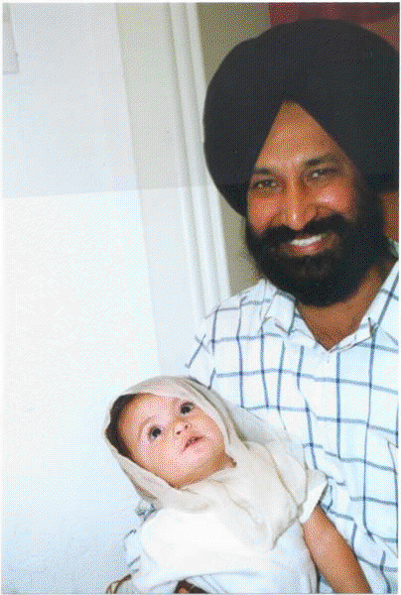
The Sikh was hurt to hear his friend’s comments.
He got hold of a book on Sikh faith and found out that cutting hair is a cardinal sin.
He decided to keep long hair.
He told his teachers after he started keeping his hair uncut "Sir, for some days, I will look weird. Please bear with me.
You will find me good-looking when my hair grows long and I start wearing a turban. Keeping uncut hair is a requirement for a Sikh.”

Slide 4
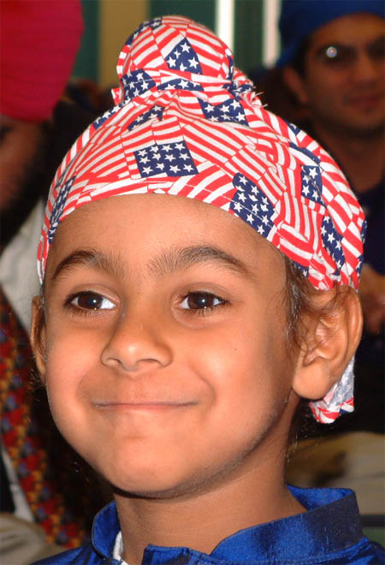
Baba Ji, My Joori?
In the Ross Street gurdwara Vancouver, Canada small boyWith emotion and love-filled words, he said, “Baba ji, see my joori,(hair knot on his head)”
It is imposimpossible for me to express his joy and feelings in words. I thought he wanted me to tie his hair-knot securely. When I touched it, I found it tight and well done.
. I told the boy, “Dear, it is okay.”
He went on, “Baba Ji, I told you, I will not cut my hair.
They are long enough now, and I can tie them in a joori.”

Slide 5
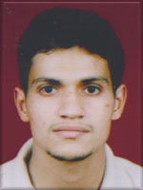
I was moved with his love for his uncut hair. I remembered his face when he was without a turban some weeks earlier at a Sikh youth camp.
. I lifted him in my arms and asked, “Where is your dad?” The boy looked around and pointing to his father, standing only a few steps away, said, “There he is.”
Looking at his father who was without a turban, a deep chill went through my body. I could not open my mouth to utter a single word.
I do not know even now what to say to such a father in situation like that.

Slide 6
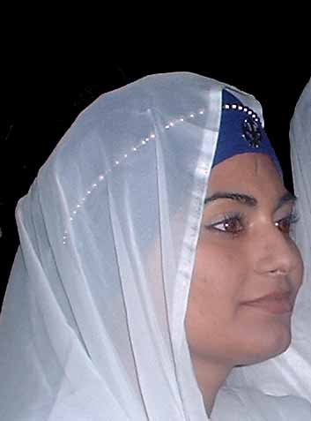
Amritdhari Sikh
A girl studying law was considered to be a role model for the Sikh youth.
She was quite often invited to address the youth attending the camps.
Her father who did not wear turban, once remarked to her, “ It is okay if you keep long hair but do not get involved into the ritual of amrit shak”.
Amrit ceremony was to be conducted next week in a near by town.
She went there, took amrit, and started tying a turban.
I know many Amritdhari Sikhs whose parents were/are non-Keshadhari.
This makes me believe that it is the will of God, not merely one’s efforts that one lives a Gurmat life.

Slide 7
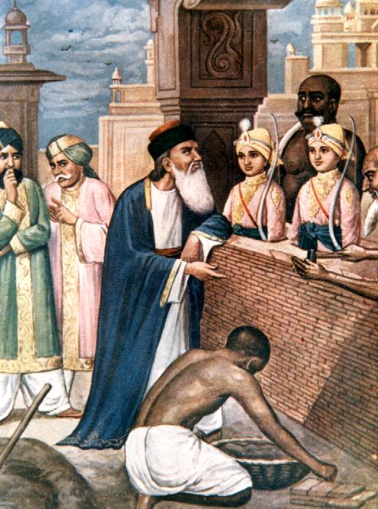
Can I Tie a Turban?
Khalsa School Vancouver held a camp in 1987 in the gurdwara at Vernon, an interior town in British Columbia.
I told the Sakhi of the two younger sons of Guru Gobind Singh to a junior group of 8-10 years.
After describing the brave and fearless sacrifices of Baba Zorawar Singh and Baba Fateh Singh, I concluded, “Look! Their martyrdom teaches us the supreme value of the faith.
They preferred their faith to life. That is why we remember all such martyrs in our prayer by saying,

Slide 8
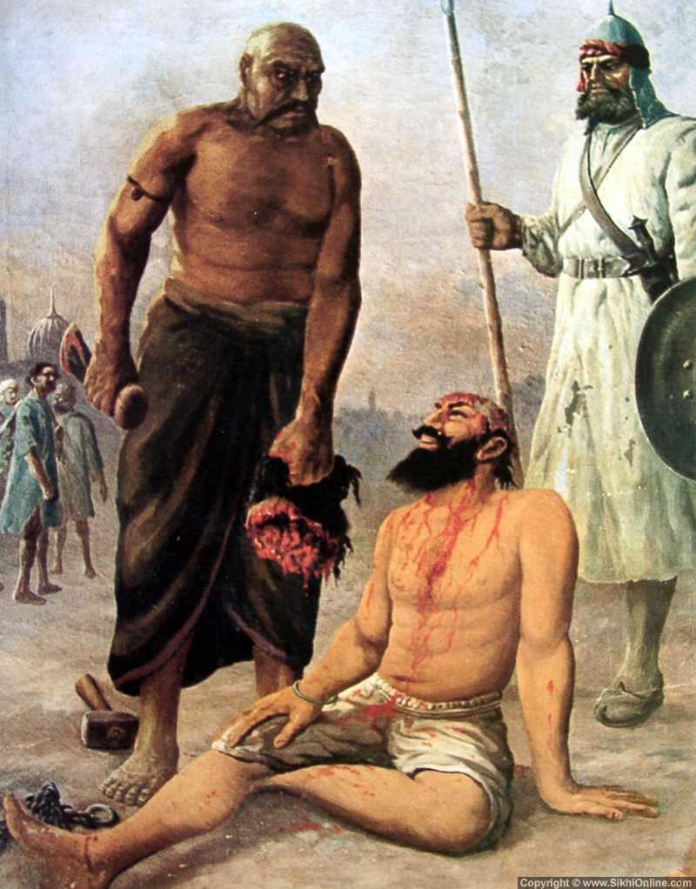
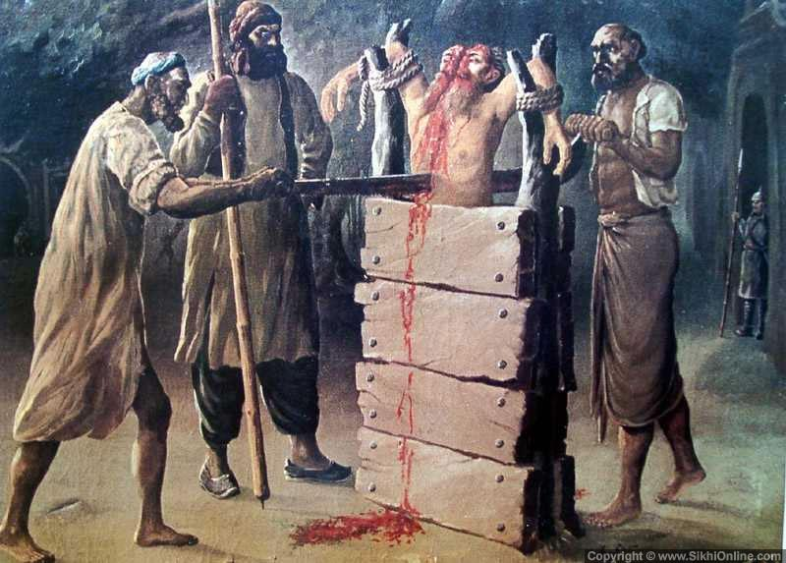

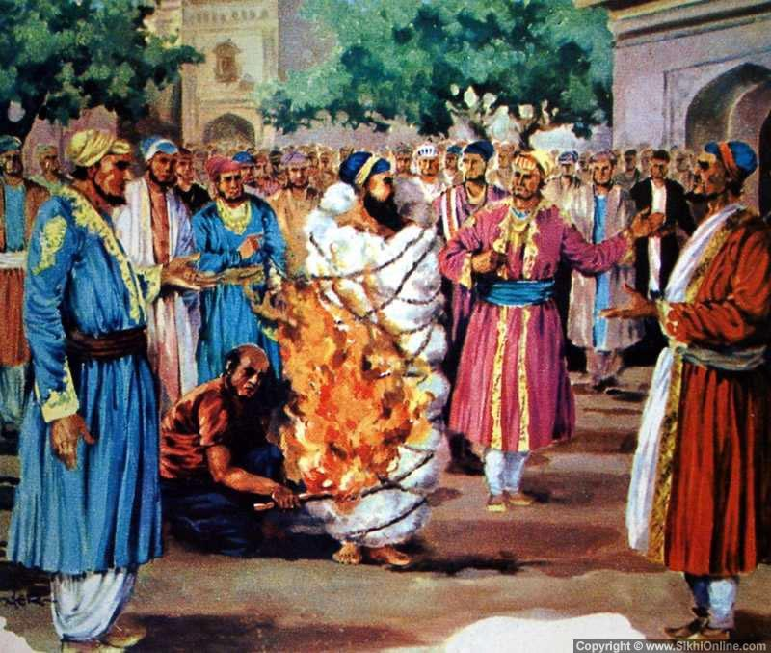
 – those who remained committed to their faith by keeping their hair uncut as long as they could breathe, i.e. were alive.
Why should we disrespect our faith (destroy our identity) by removing our turban and cutting our hair.”
The boys were so much moved by the sacrifices of the young sons of Guru Gobind Singh that they asked me a very unusual question, “Baba ji, we do not have long hair, can we tie a turban? We will not cut our hair again.”
MARTYRS

Slide 9
When I was listening to their strong feelings of repentance for having cut their hair and their desire to tie turbans, the director of the camp passed by the group.
Pointing towards him, I said, “He is here. I will ask him to give you turbans. Those who would like to tie turbans, please raise your hands.” All the boys stood up and in one voice, said, “I want a turban.”
The director was so much impressed by the desire of the youth that he ordered more turbans to be sent by the first available bus from Vancouver to Vernon.
The next day, all the children wearing turbans changed the very look and psyche of the youth camp.

